Slide 1

Controlling Player Avatars in Game Worlds using Multi-Modal Input Systems
Final Year Project: Progress Presentation
Notes:
My project is about building a system that will allow for the combined acquisition and analysis of real-time data from EEG, EMG and eye-tracking devices. Using said system, behaviours and interactions with a game world will be explored, with the two examples being avatar skeletal rig control and game difficulty scaling.

Slide 2
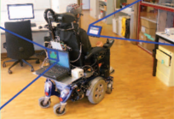
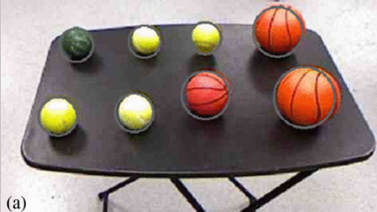
Literature Review: Key Studies
Brain-controlled wheelchairs: a robotic architecture [ 6 ]
The authors of the paper used a 16 electrode EEG headset to capture motor imagery data, feeding these signals, along side the results of a computer vision network, into a multi-modal input and analysis system they where able to allow for the real time control of a wheel chair for motor impaired person. Allowing for the disregarding of ERP’s, and the constant stopping to verify user inputs, the system used path finding, and obstacle avoidance to infer meaning from where the user wanted to go rather then the typical left and right responses seen in motor imagery work.
Demonstration of a semi-autonomous hybrid brain--machine interface using human intracranial EEG, eye tracking, and computer vision to control a robotic upper limb prosthetic [ 14 ]
Using computer vision, eye tracking and motor imagery based EEG the authors of the study where able to get a prosthetic arm to pickup objects when the user tried to do so. This showed reasonably accuracy with both when the arm activated and for what object it reached. This was made more accurate by removing the direct control from the user, and leaving much of the more difficult manoeuvring of the arm to IK models.
Brain-controlled wheelchairs: a robotic architecture
Notes:
There are three main examples of similar system having previously been developed that I would like to mention, prosthetic arm thing
- Wheel chair

Slide 3
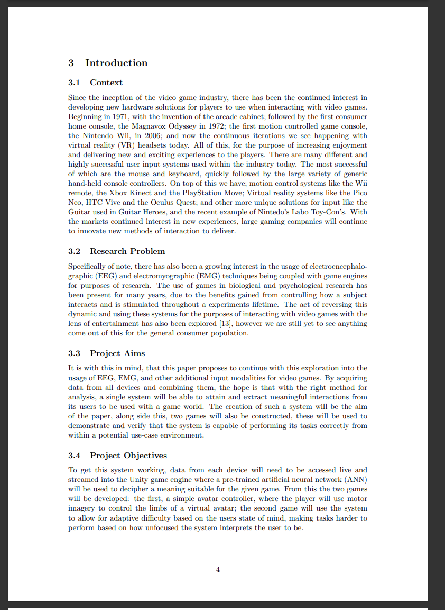
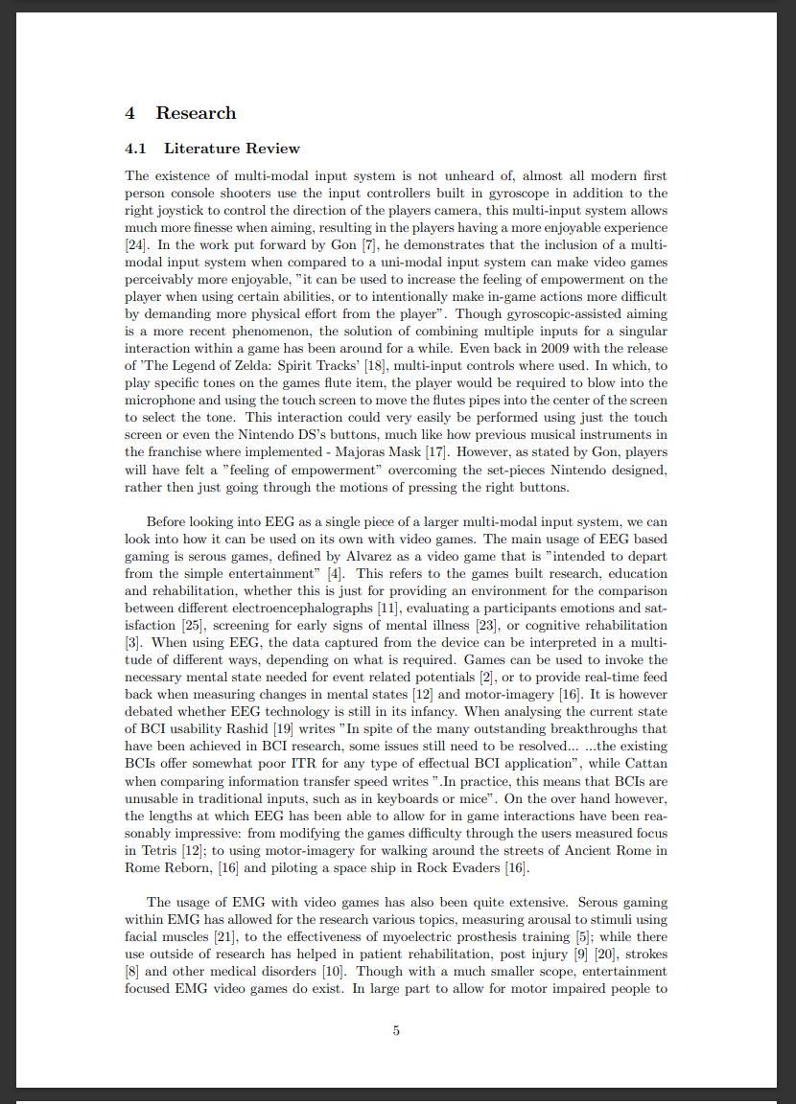
The Dissertation Progress
Introduction
Context
Research Problem
Project Aims
Project Objectives
Lit Review
Current examples of multi-modal input systems
Uni-modal EEG systems in gaming
Uni-modal EMG systems in gaming
EEG / EMG based multi modal input systems
Reference Count: 23 papers
Roughly 2000 words
Notes:
All secion

Slide 4
Processing
Barracuda
Tensorflow -> ONNX -> Barracuda
Tensorflow
XOR
Offline processing
Open Vibe
Data Capture
LSL
EEG
What I have done Prototype

Slide 5
Faces
EEG reading
Project I have worked on

Slide 6
60 Second Showcase
YouTube Link

Slide 7
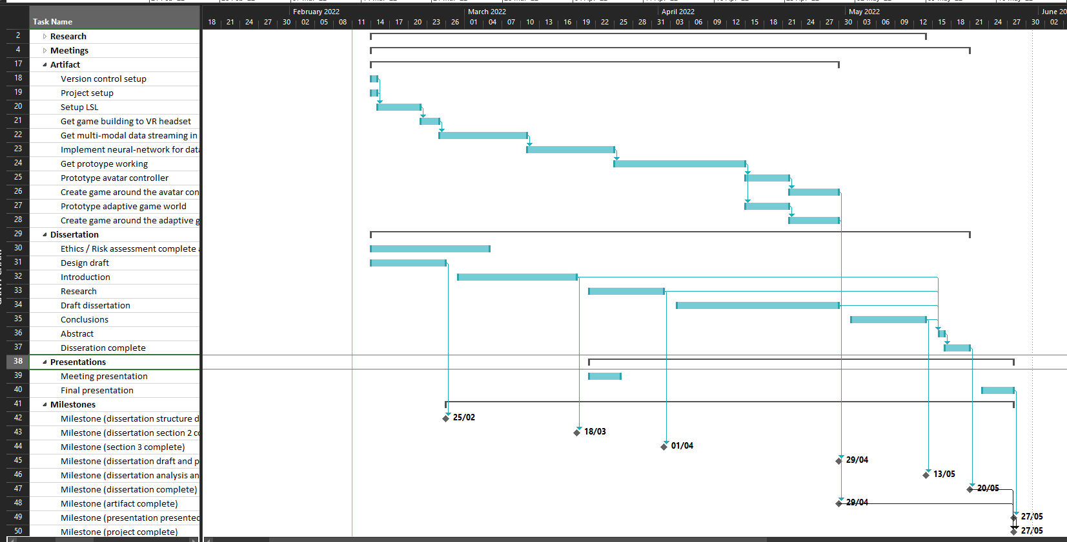
Where am I?
Today
Project Plan:
Artifact
Setup Version Control
Setup Unity Project
Get LSL working across devices
Implement Neural Network for data analysis
Setup Tensorflow online analysis through Unity
Design and train a network using offline EEG / EMG data
Dissertation
Ethics / Risk assessment hand in.
Dissertation Draft
Introduction – (draft)
Literature Review – (draft)

Slide 8
Future Plans
Next few weeks:
Artifact
Get a working offline analysis model for EEG motor-imagery classification.
Then get this working in real time with Unity, though this will still be feeding in offline data.
Do the same for the Emotibit, EMG data.
Dissertation
Polish up drafted sections and continue the literature review.
Start methodolgy
Later:
Artifact
Modify the neural networks to support the analysis of all modalities instead of just them separately.
Train this to accomplish specific tasks, such as moving avatar skeleton bones, or influencing the difficulty of a simple game.
Get two demonstration games built to demo the system.
Dissertation
Finish methodology

Slide 9
